Slide 1

FigmaDev Accelerator: AI-Powered Design-to-Code
Bridging the gap between design and development with AI
AS
by Advik Sarang

Slide 2





The Challenge: Bridging Design & Development
Slow & Costly
40-60% of frontend dev time
Design Fidelity Loss
30% of details lost in handoff
Inconsistencies
Design system compliance difficult
High Cost
$120K-$180K annually per team

Slide 3






Our Vision: LLM-Powered UI Generation
AI-Powered Pipeline
Design to production code
FigmaDev Accelerator
Smart plugin + AI processing
Accelerated Development
Reduce effort, high fidelity

Slide 4





The Solution: FigmaDev Accelerator Workflow
Figma Design
Figma Plugin
AI Processing
Final UI Code
Auto Layout, Styles
Data Extraction, JSON Output
LLM Generation
HTML/CSS/JS

Slide 5
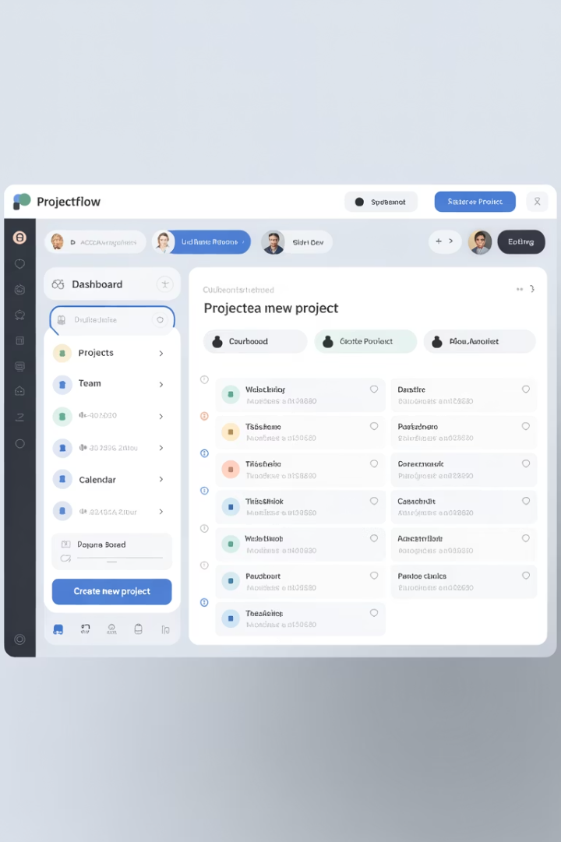
Step 1 - Design Intelligently in Figma
Auto Layout
Essential for responsive layouts
Consistent Naming
Clear layer names for better mapping
Clean Hierarchy
Logical organization in Frames
Styles & Variables
Apply design system tokens

Slide 6





Step 2 - Intelligent Data Extraction (Plugin)
HTML Structure
Semantic structure from layout
CSS Styling
Detailed rules and properties
Design Tokens
Colors, typography, spacing
Layout Specs
Auto Layout properties
Component Info
Names, variants, properties

Slide 7
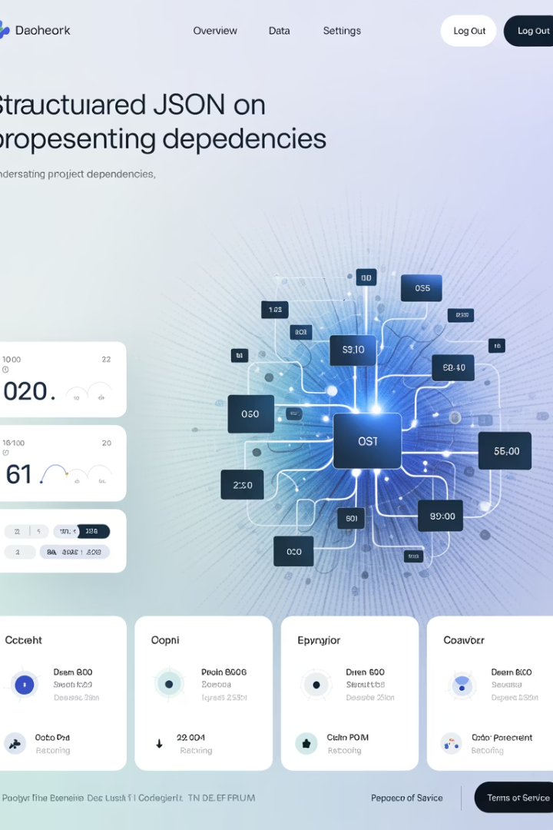
The AI Data Package (Example JSON)
{
"metadata": { "source": "FigmaDev Accelerator v1.0" },
"structure": { "html_tree": "
...
" }, "styling": { "css": ".container { display: flex; ... }", "designTokens": { "colors": {"primary": "#426B1F"}, "typography": {"heading1": {"fontFamily": "Newsreader"}} } }, "layout": { "autoLayout": [{"direction": "row", "gap": 16}] } }

Slide 8
Step 3 - AI Processing & Code Generation
Analyze
Design system tokens and structure
Generate
Semantic HTML/Component structure
Apply
Styling using extracted CSS
Optimize
Responsiveness from Auto Layout
Enhance
Basic accessibility features

Slide 9
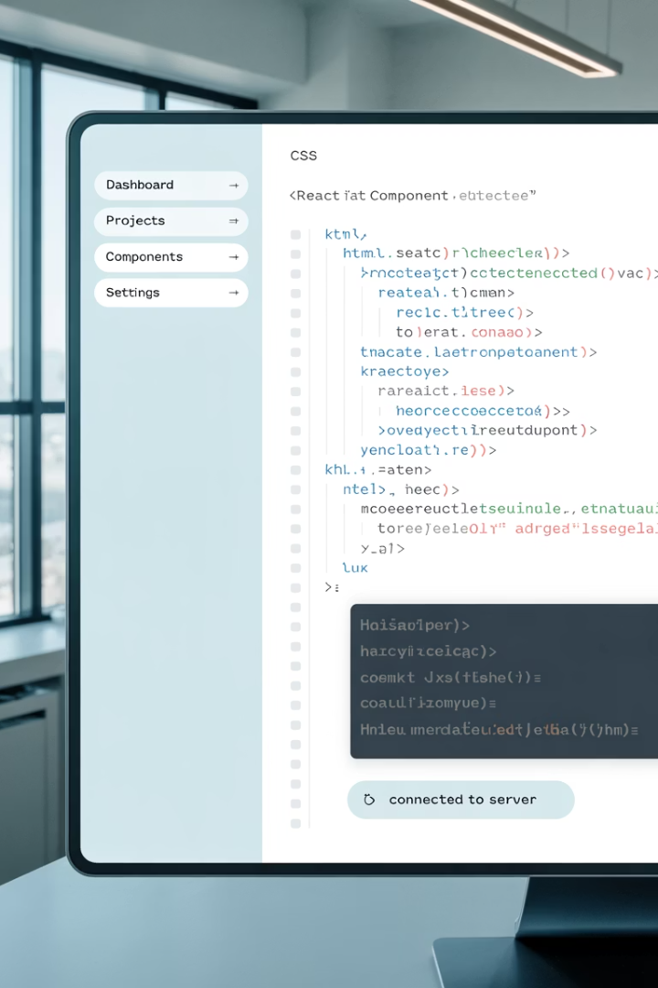




The Output: Production-Ready Scaffolds
Semantic HTML
Design System Integration
Responsiveness
Well-structured markup
Layouts from Auto Layout
CSS Variables from tokens
Accessibility
Basic ARIA support

Slide 10
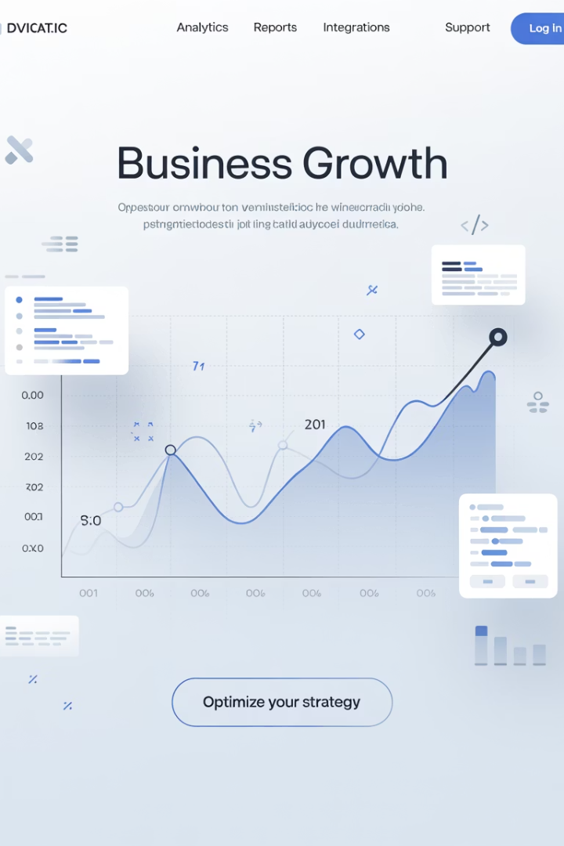
Business Value & ROI - By the Numbers
4x
Speed Increase
Faster UI implementation
$110K+
Annual Savings
Per frontend team
35%
Faster Delivery
Feature delivery cycles
60%
Resource Freed
UI dev hours for innovation

Slide 11
Case Study: E-commerce Redesign
Challenge
Results
Complex UI redesign of product listing pages
6 weeks → 2 weeks (67% reduction)
Strict design system requirements
3 additional design iterations
100% design system compliance
~$45K direct cost savings

Slide 12








Transforming the Workflow
Developer Experience
Design Team Benefits
Focus on business logic, not CSS
More creative freedom, faster iterations
Team Collaboration
Technical Leadership
Reduced friction, faster feedback
Reduced tech debt, enforced standards

Slide 13
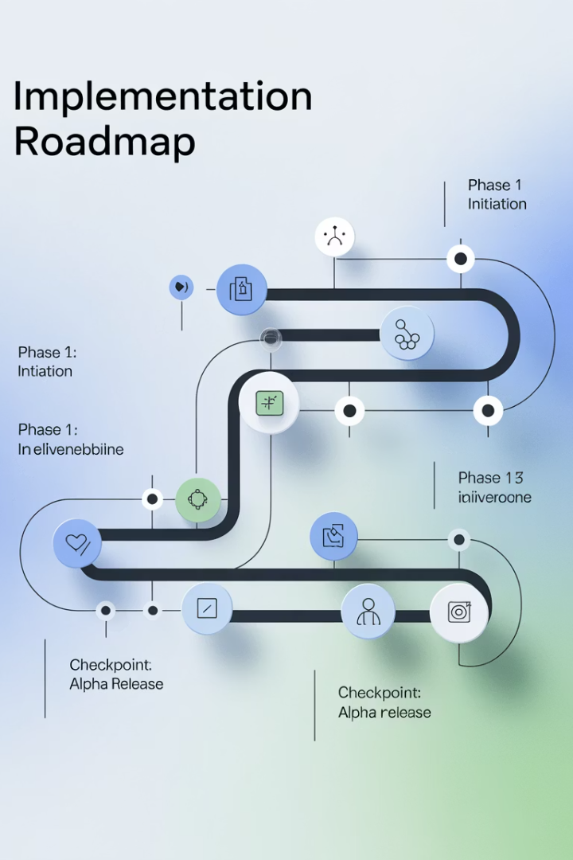




Getting Started & Implementation
Phase 1 (2 weeks)
Install plugin, setup, training
Phase 2 (2-3 weeks)
Integrate with workflows
Phase 3 (3-4 weeks)
Pilot project, fine-tuning
Phase 4 (2 weeks)
Full production rollout

Slide 14


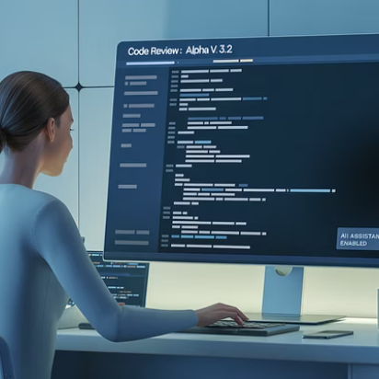

Risk Mitigation
Learning Curve
Integration
Intuitive tools, focused training
Augments existing tools
AI Reliability
Change Management
Human review checkpoints
Phased rollout, clear metrics

